Slide 1

Credit Card Fraud Detection
Guided By
Mr.Vishnu Prakash Sharma

Slide 2

Problem Statement
The CreditCard Fraud Detection Problem includes modelingpast credit card transactions with the knowledge of the ones that turned out to be fraud. This model is then used to identify whether a new transaction is fraudulent or not. Our aim here is to detect 100% of the fraudulent transactions while minimizing the incorrect fraud classifications.
The credit card fraud detection features use user behaviour and location scanning to check for unusual patterns. These patterns include user characteristics such as user spending patterns as well as usual user geographic locationsto verify his identity. If any unusualpattern is detected, the system requires revivification.

Slide 3
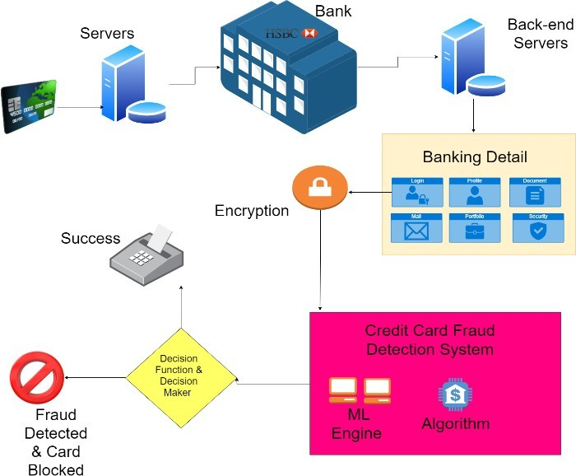

Slide 4
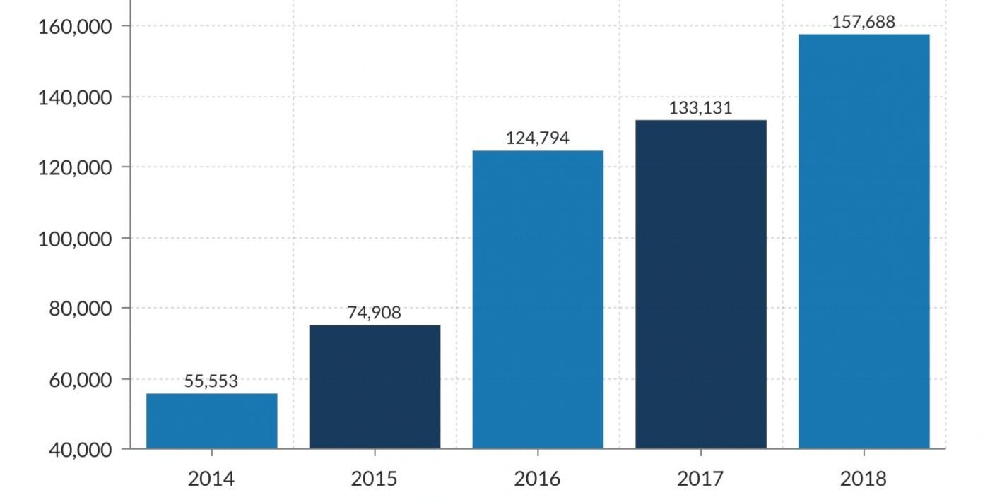
Frauds over the years

Slide 5
Testing Process
. We choose Credit Approval Dataset due to its contents i.e. it contains about 15 features divided into 3 classes (integer, real and categorical) which would surely help in training the model to achieve a high accuracy. This dataset was very interesting because there was a good mix of attributes -- continuous, nominal with small numbers of values, and nominal with larger numbers of values. There were also a few missing values. For building the neural network used keras with TensorFlow as a backend to build the network.
The network is a 3-layer network with 11 input nodes 3 nodes in middle layer and one node in Output layer. Visualization of the results is done using Matplotlib

Slide 6
Project Timeline
Week 1
Choosing project
Studying research paper
Setting Environment
Week 2
Gathering data
Choosing libararies
Trainnig data
Week 3
Testing model
Enhancing algo for optimization
Prediction of result
Week 4
Frontend Coding
Frontend design
Validating the web application
Week 5
Deployed backend on django
Backend connected to local server
Final Outlook
Task name
Task name
Task name

Slide 7
Results & Findings
Our model achieved a accuracy of 94.49 % for fraud detection and the affected population (which were considered fraud but were not fraud was found to be 22.60 %. The results mayvary if you run the same jupyternotebook because initialization of the weightsof the nodes of SOM grid is done by randomly selecting the records/ patterns from the input space i.e. randomly selecting the records from the given dataset. Since,we have done training for 100 iterations and weights are randomly initialized every time, convergence may vary. We may try with different iterations like 100, 150, 200 etc. to have betterconvergence. You may also store the weightsof the SOM for which you achievebetter accuracy.

Slide 8
Conclusion
From the above comparative analysis of the various creditcard fraud detection techniques it is clear that Artificial Neural Networks performs best in this scenario. But the drawbacks of Artificial Neural Networks is that they are very expensive to train and can be easily over trained. In order to minimize their expense we need to create a hybrid of neural network with some optimisation technique. Optimisation techniques that could be successfully paired with Neural Networkare Genetic Algorithm, Artificial Immune System,Case Based Reasoningand any other similar optimisation technique

Slide 9

Resources
[1] Dataset: http://archive.ics.uci.edu/ml/datasets/Credit+Approval
IEEE Technical Paper:
https://www.researchgate.net/publication/334761474_Real- time_Credit_Card_Fraud_Detection_Using_Machine_Learning
[4]Website:
https://towardsdatascience.com/credit-card-fraud-detection- using-self-organizing- featuremaps-f6e8bca707bd

Slide 10
Does Anyone Have a Questions?

